Slide 1

Activity and sequence diagram
Sanzhar Kipshakbaev

Slide 2
Activity and sequence diagram
A UML sequence diagram is a diagram that shows the interactions of objects, ordered by the time of their manifestation. The main elements of the sequence diagram are: object designations (rectangles), vertical lines showing the passage of time during the activity of the object, and arrows showing the execution of actions by objects.
The activity diagram shows the flow of transitions from one activity to another. Activity is a non-atomic step of calculations in an automaton that continues in time.

Slide 3
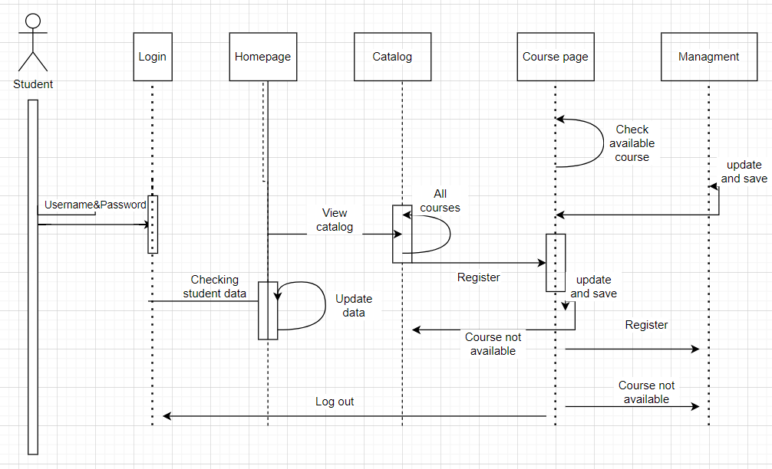
Activity diagram

Slide 4
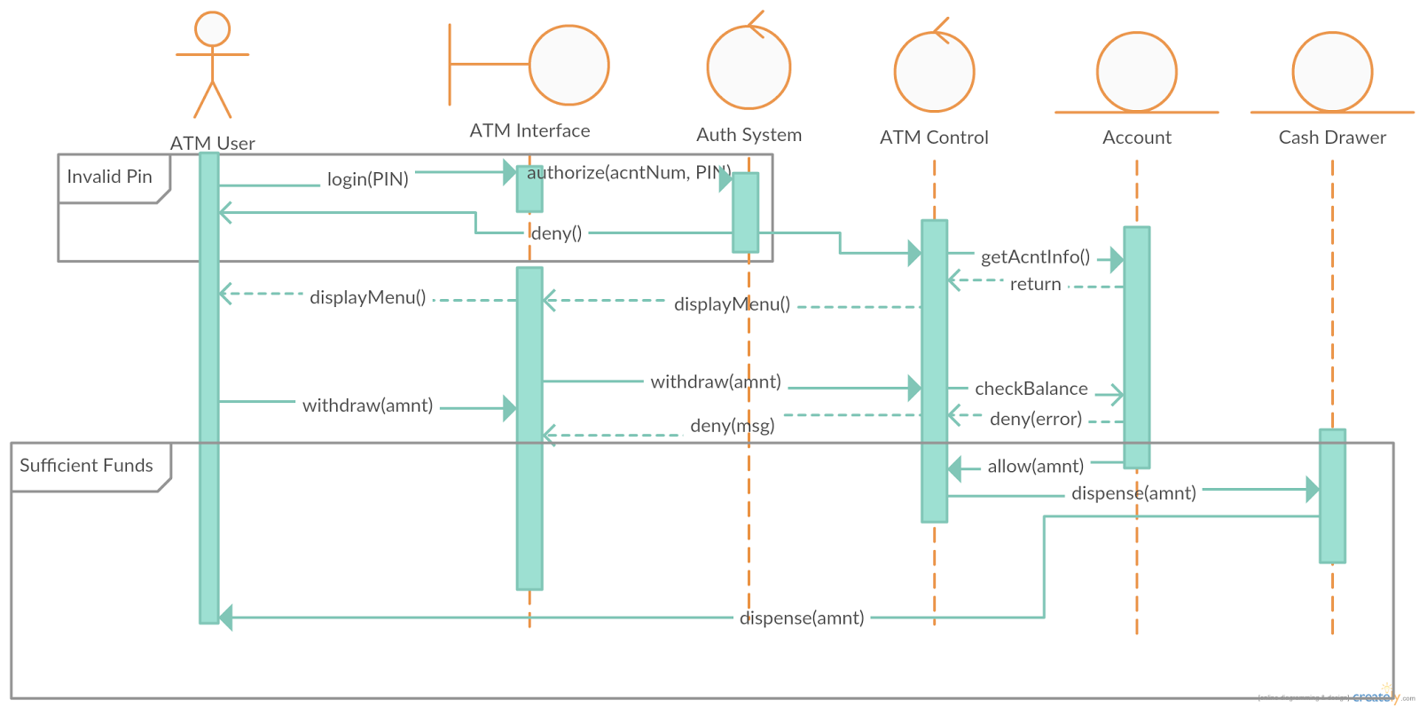
Sequence diagram

Slide 5

Explain why you might want to develop both activity and sequence diagrams when modeling the behavior of a system
Both activity and sequence diagrams model a system, but each gives a different view. Activity diagrams track the process flow, modeling the functionality of the system. Sequence diagrams track the flow of information between objects of the system, often down to the method and parameter level. Activity diagrams may be easier for the client to understand, while sequence diagrams add ideas that can be extracted by a coder or implementer of the system.

Slide 6

Thank you for your attention

